Slide 1
COVID-19 Tweets of Governors and Health Experts
Slides and paper available at go/Tim
TIM HUA, Chris Kim, Zihan ZHang, & Alex Lyford

Slide 2
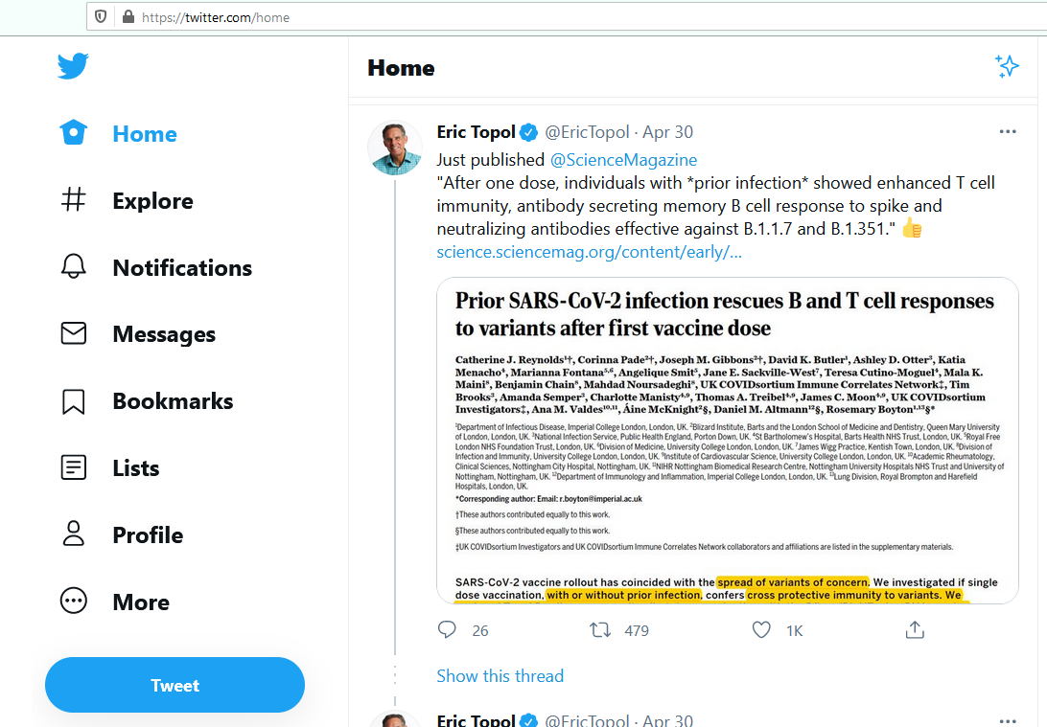
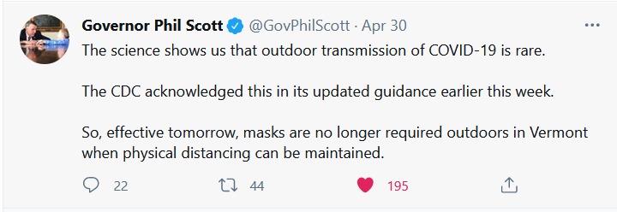

Slide 3
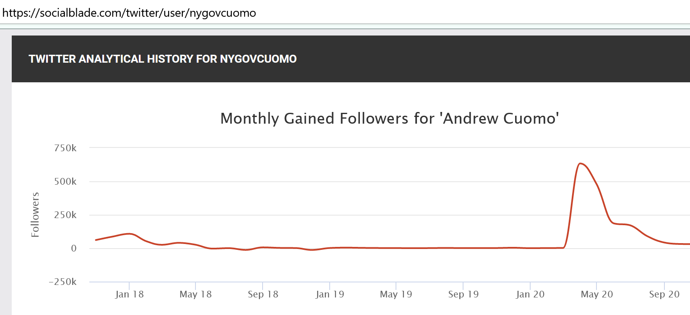
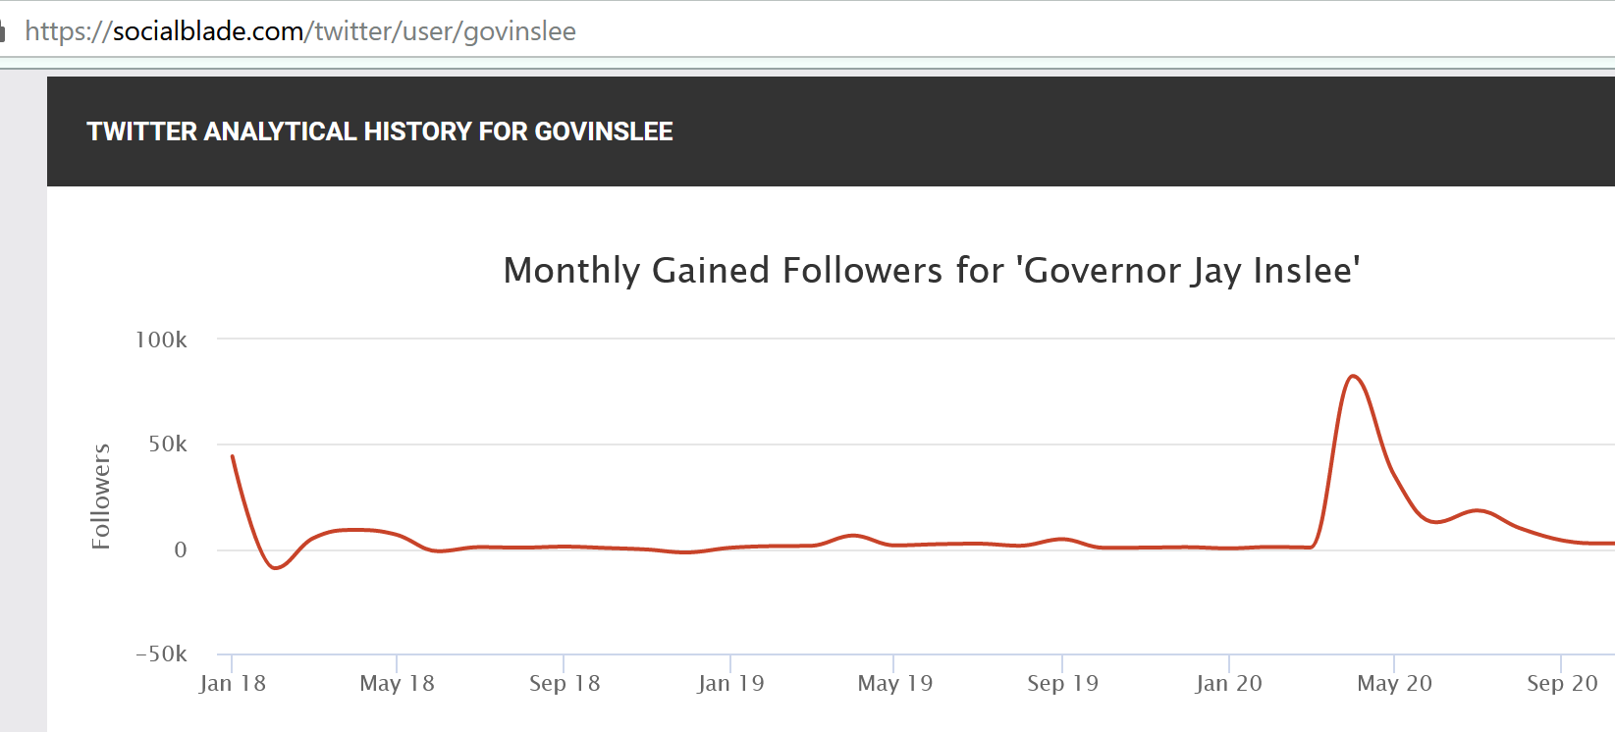
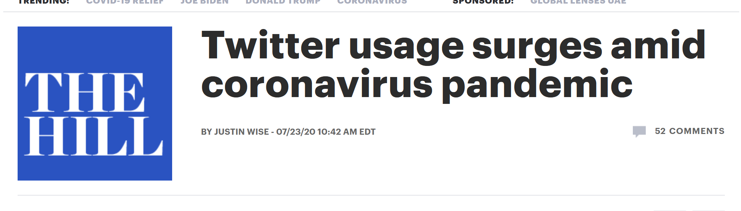
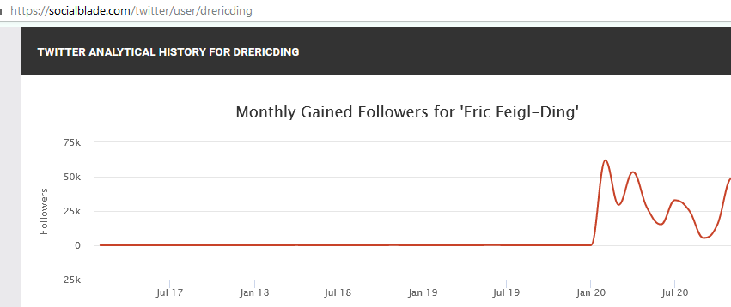
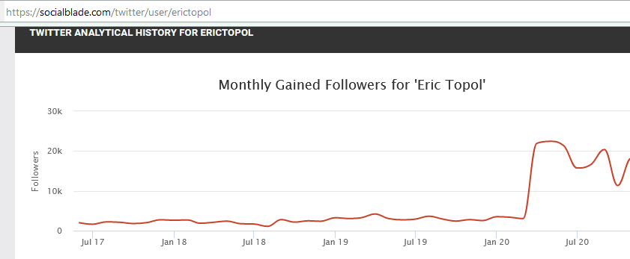
Why Care?
Notes:
COVID-19 Dominated News Cycle, states lead response, governor following go brr

Slide 4
Research Questions
RQ1: Do Democratic governors and Republican governors differ in how often they tweet about COVID-19?
RQ2: Do Democratic governors, Republican governors, and Health Experts (henceforth referred together as DRHs) differ when talking about the consequences of the pandemic?
RQ3: Do DRHs differ when talking about solutions to the pandemic?
RQ4: Do DRHs differ in the prevalence of technical language in their COVID-19 related tweets?
RQ5: If there are differences between Democrat and Republican governors in the aforementioned research questions, are the differences more due to state-level COVID-19 data, or is party affiliation the driving force behind the differences in how members of the two parties’ tweet?
Notes:
Mention that consequences mean economy vs death In other words, a question we will seek to answer is “Do Democratic governors tweet more about death because there is more death in Democrat-led states, or because they are Democrats?”

Slide 5
Methodology
All Tweets from Jan 1st, 2020 to October 18th, 2020
Governor’s most followed account
46 U.S.-based health experts
At least 20,000 followers
Tweet about COVID-19 at least 33% of the time in April
Hold a MD, MPH, or a Doctorate/Professorship in epidemiology, biology, virology, or a related field.
Aim to find accounts that people turn to for COVID-19 information from a trusted, professional source.
Convivence sample, but better than relying on lists gathered by media sources

Slide 6
Methodology
Used a custom word count program and custom dictionaries
Is a word from a dictionary in a tweet? How many tweets contain words from the given dictionary?
Answer the question: How often do a user/ group mention a topic
(Dictionary details available in appendix of paper)

Slide 7
Example
To answer RQ2, we looked at how often governors mentioned death-related words versus economy-related words in tweets containing COVID-19 related words
Death related words: die, dead, death, dying, coffin
Economy related words: employment, economy, jobs, business, stock market

Slide 8
Methodology
Compare prevalence rates of words:
Number of Tweets mentioning COVID-19 ÷ Total Number of Tweets
Number of Tweets mentioning death ÷ Number of Tweets mentioning COVID-19
Number of Tweets mentioning the economy ÷ Number of Tweets mentioning COVID-19
and so on….

Slide 9
Results

Slide 10
Results

Slide 11

Regression Analysis
$Prevalence Rate_{i}=β_{0}+ β_{1}∗P_{i}+ β_{2}∗C_{i}+β_{3}∗D_{i}+β_{4}{∗T}_{i}+ε_{i}$
$P_{i}$ = Party affiliation of governor (Republican = 1)
$C_{i}$ = Cases per 100,000
$D_{i}$ = Deaths per 100,000
$T_{i}$ = Tests per 100,000

Slide 12
Regression Analysis
Response Variable | β₀ | β₁ | β₂ | β₃ | β₄ | R²
COVID-19 Tweets | 0.400 | 2.42% | -3.15E-05 | 2.25E-04 | 0.116 | 13%
Death Tweets | 0.050 | -2.73% | -7.26E-06 | 1.07E-04 | 0.024 | 17%
Econ Tweets | 0.138 | -0.40% | 9.90E-07 | -4.52E-04 | -0.022 | 12%
Tech Tweets | 0.017 | 0.54% | -6.99E-06 | 3.21E-04 | 0.039 | 18%
Solution Tweets | 0.445 | -8.97% | -4.70E-06 | 6.28E-04 | 0.042 | 19%
Home Tweets | 0.182 | -6.23% | -6.43E-07 | -3.83E-04 | 0.064 | 16%
Test Tweets | 0.154 | 1.10% | -9.30E-06 | 7.87E-04 | 0.090 | 18%
Mask Tweets | 0.150 | -5.80% | 9.32E-06 | 7.06E-05 | -0.085 | 17%
Vaccine Tweets | 0.009 | 0.10% | -1.09E-06 | 1.40E-05 | -0.004 | 3%

Slide 13
Further Analysis: Death and Economy
We were curious about the massive difference in death-related tweets
Death and economy are two things that governors talked about pre-pandemic as well (as opposed to masks)
 | Total Tweets | Total Death Tweets | Total Death Tweets/ Total Tweets
Democratic Governors (2019) | 17,019 | 310 | 1.82%
Republican Governors (2019) | 15,260 | 139 | 0.91%
Democratic Governors (2020) | 29,297 | 1,294 | 4.42%
Republican Governors (2020) | 26,813 | 427 | 1.59%
74% increase in death-related tweets for Republicans, 143% for Democrats

Slide 14
Discussion/Future Directions
We believe we have substantial evidence that Democratic Governors are more comfortable talking about death than Republican Governors
Generalize to other politicians?
Possible explanation: Moral Foundations Theory
Future researchers could see if this death aversion extends itself to policies
Cross cultural analysis on talking about death
Parties in other countries
Norway vs Sweden

Slide 15
Special thanks
Professor Eric Bleich
Cooper Kelly
Professor Jim Ralph
Professor Julia Berazneva
Slides and paper available at go/Tim

